Slide 1

Unit II : Protocols for IoT

Slide 2

Unit-2
Messaging and Transport Protocols
Messaging Protocols
- Message Queueing Telemetry Transport(MQTT)
- Constrained Application Protocol(CoAP)

Slide 3
MQTT protocol
MQTT stands for Message Queuing Telemetry Transport.
MQTT is a machine to machine internet of things connectivity protocol.
It is an extremely lightweight and publish-subscribe messaging transport protocol.
This protocol is useful for the connection with the remote location where the bandwidth is a premium.
The MQTT was developed by Dr. Andy Stanford-Clark, IBM, and Arlen Nipper.

Slide 4
These characteristics make it useful in various situations, including constant environment such as for communication machine to machine and internet of things contexts.
It is a publish and subscribe system where we can publish and receive the messages as a client.
It makes it easy for communication between multiple devices.
It is a simple messaging protocol designed for the constrained devices and with low bandwidth, so it's a perfect solution for the internet of things applications.

Slide 5
Characteristics of MQTT
The MQTT has some unique features which are hardly found in other protocols. Some of the features of an MQTT are given below:
It is a machine to machine protocol, i.e., it provides communication between the devices.
It is designed as a simple and lightweight messaging protocol that uses a publish/subscribe system to exchange the information between the client and the server.
It does not require that both the client and the server establish a connection at the same time.
It provides faster data transmission, like how WhatsApp/messenger provides a faster delivery. It's a real-time messaging protocol.
It allows the clients to subscribe to the narrow selection of topics so that they can receive the information they are looking for.

Slide 6
Publish/Subcribe model:
MQTT users publish subscribe pattern
A component called central broker plays a key role in the entire system
This message broker helps to dispatch Message to the notes that have subscribed
The publisher Sends the messages to the broker and the broker takes the responsibility of dispatching the messages to the subscribed destinations .

Slide 7
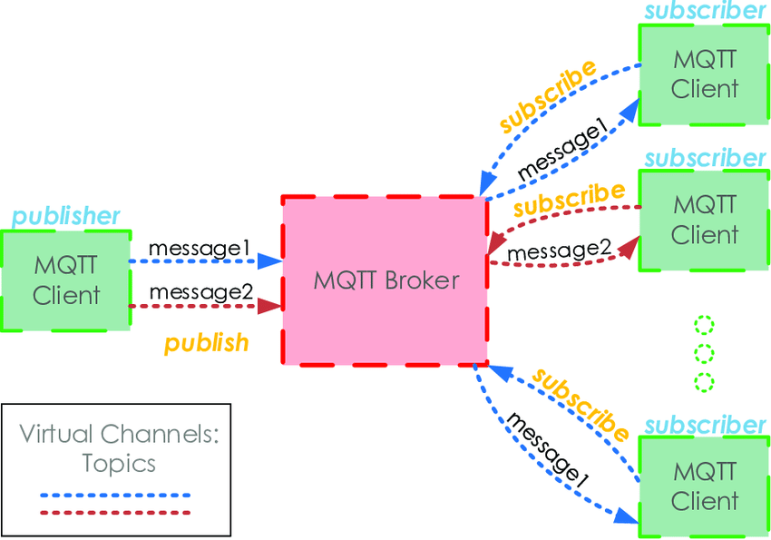

Slide 8
From the figure, a publisher can send the data to the MQTT broker.
Based on the subscriptions from the nodes connected, the broker sends the messages .
The data is captured by the nodes that have expressed interest through subscription .
the messages are published as topics and publisher publishes the messages with the topic.
Client subscribe to the topic will get the messages based on the subscription.

Slide 9
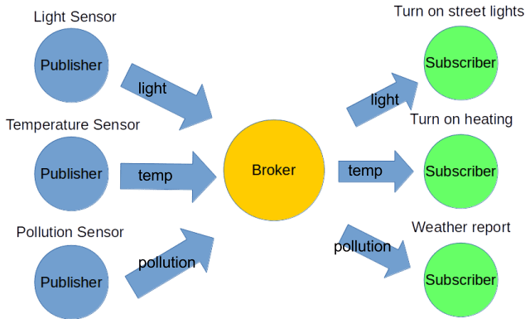

Slide 10
In a networking system, the address connects the source to the destination.
Here, clients do not have any address and hence topics are used . messages are sent as topics and brokers filter the messages based on the topic subscribed, which will then be send to the respective subscribers
hence topics are used to connect the publisher to the subscriber.
In MQTT protocol, the clients who are subscribers can also publish.
Once the messages reached the clients the message gets removed from the broker. Therefore, the life of the message is limited that is it automatically gets deleted.

Slide 11
MQTT Architecture
The components of the MQTT are,
Message
Client
Server or Broker
TOPIC
Message
The message is the data that is carried out by the protocol across the network for the application. When the message is transmitted over the network, then the message contains the following parameters:
-Payload data
-Quality of Service (QoS)
-Collection of Properties
-Topic

Slide 12
MQTT Client:
In MQTT, the subscriber and publisher are the two roles of a client. The clients subscribe to the topics to publish and receive messages.
Publish: When the client sends the data to the server, then we call this operation as a publish.
Subscribe: When the client receives the data from the server, then we call this operation a subscription.
MQTT client collects information from sensors and connects it to the messaging server.

Slide 13
Server or Broker:
The device or a program that allows the client to publish the messages and subscribe to the messages. A server accepts the network connection from the client, accepts the messages from the client, processes the subscribe and unsubscribe requests, forwards the application messages to the client, and closes the network connection from the client.
Each connection to the broker can specify a quality of service (QoS) measure.These are classified in increasing order of overhead:
-At most once – the message is sent only once and the client and broker take no additional steps to acknowledge delivery (fire and forget).
-At least once – the message is re-tried by the sender multiple times until acknowledgement is received (acknowledged delivery).
-Exactly once – the sender and receiver engage in a two-level handshake to ensure only one copy of the message is received (assured delivery).

Slide 14
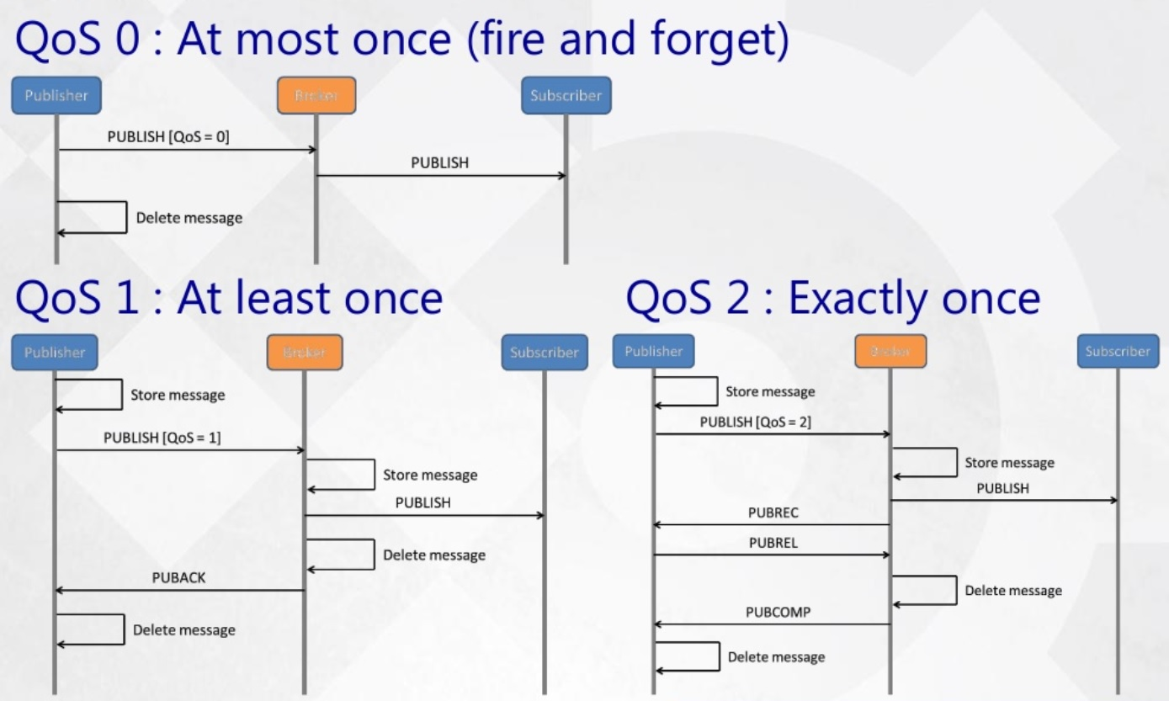

Slide 15
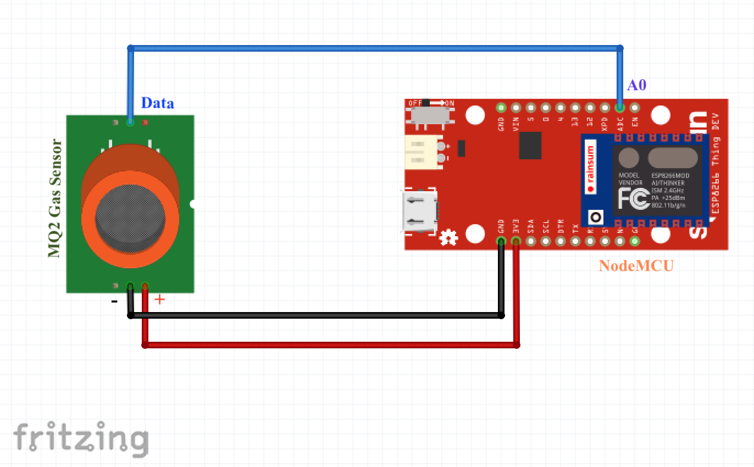
MQTT subscribe implementation example
An MQ2 sensor is interfaced with node MCU as shown in figure
the sensor senses the gas data and pushes it to the cloud through NodeMCU which is one of the nodes. This node is referred as publisher.
The process of transmission is taken care by MQTT protocol.
Adafruit cloud service provider acts as the broker and takes care of the subscribers provided with appropriate messages.
The gas sensor will read the gas data in the environment. The data will be sent to the NodeMCU and further to the cloud.
the process of publishing data to the cloud is referred to as publishing.
Adafruit cloud acts as the broker

Slide 16
MQTT subscription process
the process of subscription and publishing is almost similar with minor differences.
the data published in the cloud is to be subscribed in parallel by another node MCU.
The moment when the gas data reaches the cloud, the data will be acquired by the subscriber based on the subscription preferred.
Hence one NodeMCU will publish while the other will read through subscription look

Slide 17
Constrained application protocol (CoAP)
similar to MQTT, COAP is a lightweight protocol.
CoAP uses lesser resources than H TTP and it is not a replacement to HTTP.
H TTP is highly favored and has no constraints or restrictions. On the other hand, COAP is designed for environments with constraints.
HTTP runs over TCP and is connection oriented while CoAP runs over UDP and his connectionless.
CoAP is a simple protocol with low overhead specifically designed for constrained devices (such as microcontrollers) and constrained networks.
The main features of CoAP protocols are:
Web protocol used in M2M with constrained requirements
Asynchronous message exchange
Low overhead and very simple to parse
URI and content-type support
Proxy and caching capabilities

Slide 18
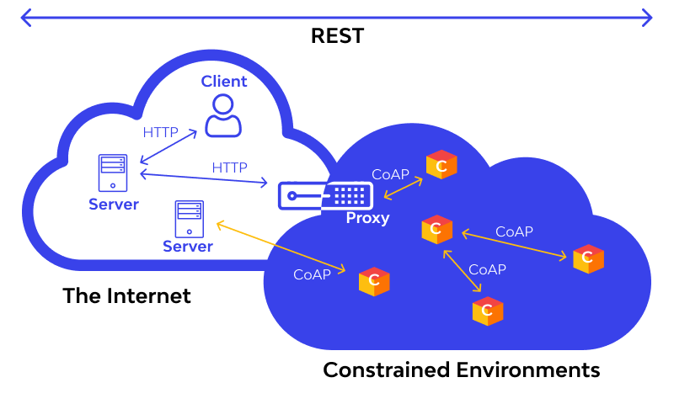

Slide 19
CoAP allows clients to talk or exchange data/information with each other within resource constraints.
To understand this architecture, knowledge of some key terms is crucial:
Endpoints are the nodes that host have knowledge of;
Client sends requests and replies to incoming requests;
Server gets and forwards requests. It also gets and forwards the messages received in response to the requests it had processed.
Sender creates and sends the original message.
Recipient gets the information sent by the client or forwarded by the server.

Slide 20
CoAP is based on the REST API model, Known as RESTful.
REST stands for REpresentational State Transfer.
In REST architecture, a REST Server simply provides access to resources and REST client accesses and presents the resources. Here each resource is identified by URIs/ global IDs.
CoAP optimizes the datagram length.
Since CoAP is based on UDP and is a connection less protocol, it requires retransmission support.
Retransmission features are supported in CoAP to address user datagram protocol(UDP) weakness.

Slide 21
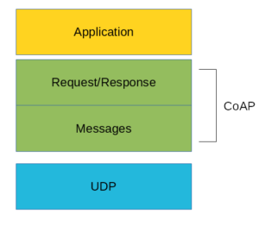
Layers of CoAP
COAP is a two layered protocol.
the lower layer is the message layer and the upper layer owns the request-response process.
The upper layer is dependent on UDP.
CoAP supports four different message types:
Confirmable
Non-confirmable
Acknowledgment
Reset

Slide 22
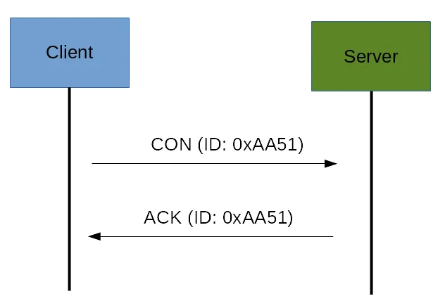
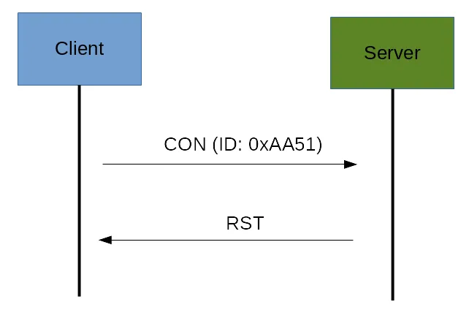
Confirmable(CON)
A confirmable message is a reliable message. When exchanging messages between two endpoints, these messages can be reliable. In CoAP, a reliable message is obtained using a Confirmable message (CON). Using this kind of message, the client can be sure that the message will arrive at the server. A Confirmable message is sent again and again until the other party sends an acknowledge message (ACK). The ACK message contains the same ID of the confirmable message (CON).
If the server has troubles managing the incoming request, it can send back a Reset message (RST) instead of the Acknowledge message (ACK)

Slide 23
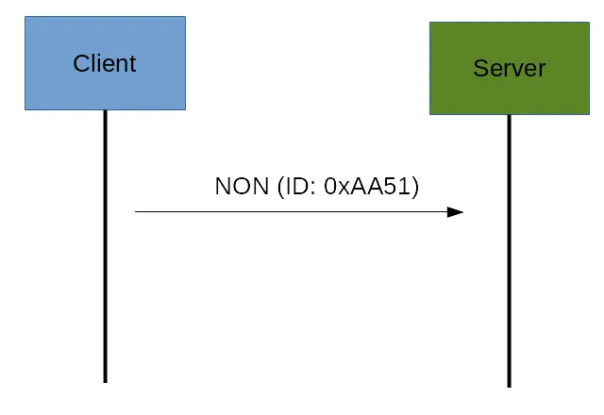
Non Confirmable(NON)
The other message category is the Non-confirmable (NON) messages. These are messages that don’t require an Acknowledge by the server. They are unreliable messages or in other words messages that do not contain critical information that must be delivered to the server.
Even if these messages are unreliable, they have a unique ID.
If no processing carried out by the receiver, RST message is sent.

Slide 24
Acknowledgement(ACK)
this is the Traditional acknowledgment message sent in any protocol .
Reset(RST)
If there is no processing at the receiver end even after certain amount of time there is a message option called reset to inform the sender that there is a problem or trouble in the transmission

Slide 25
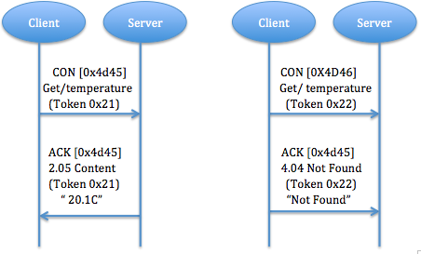
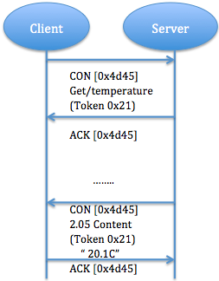
COAP request response layer messages
Piggy-backed : Client sends request using CON type or NON type message and receives response ACK with confirmable message immediately. In fig. , for successful response, ACK contain response message (identify by using token), for failure response, ACK contain failure response code.
Separate response: If server receive a CON type message but not able to response this request immediately, it will send an empty ACK in case of client resend this message. When server ready to response this request, it will send a new CON to client and client reply a confirmable message with acknowledgment. ACK is just to confirm CON message, no matter CON message carry request or response.
Fig. Piggy backed message (a) success (b) failure
Fig. Separate response

Slide 26
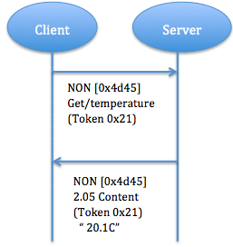
c) Non confirmable request and response: unlike Piggy-backed response that carry confirmable message, here NON type message is sent from the client to the Server. The server don't need to give ACK and will resend a NON type message as response in turn
Fig. Non confirmable request and response

Slide 27
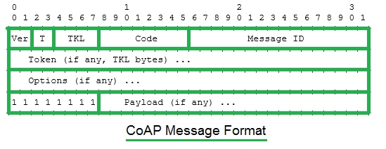
Message format
Ver: It is a 2-bit unsigned integer and refers to COAP version. In this case it is one
T:It is a 2-bit unsigned integer and refers to the message type. The message can be confirmable(0), non confirmable(1), ACK(2), RESET(3)
TKL: It is a 4-bit unsigned integer and refers to the token length. It normally ranges from 0 to 8 bytes.
Code: It refers to the response code
Message ID: It is the identifier of the message .

Slide 28
Transport Protocols
BLE (Bluetooth Low Energy)
Wi-Fi.
Li-Fi.

Slide 29

Bluetooth Low Energy – BLE
Bluetooth Low Energy – Also referred as BLE
an open low energy, short range radio technology
Named as Bluetooth Smart as well.
Designed by Bluetooth SIG (Special interest group)
It is a wireless PAN technology (Like Bluetooth protocol)
Major Application focus in
Healthcare
Entertainment
Fitness (You could be using this already)
Proximity (Car lock, Children in Mall)
Though power usage is curtailed(restricted), it is also important to note that, the same communication range is maintained.
Supported by most of the operating systems which makes it more special.
Supported by Android, IoS, Blackberry , macOS, Win 8/10, Linux.

Slide 30
Features of BLE
1. License free
2. Support to Multi brand mobile / GPOS
3. Low cost - Very much affordable.
4. Low power consumption - Very much needed in IoT infra.
5. Not huge! Really, which is another reason for us to use.
6. Good range coverage.
7. Extreme heterogeneity support!!!

Slide 31
Components of BLE
Technically BLE has three components from its architectural perspective:
1. Application
2. Host
3. Controller.
Application Block: User application sits here, interacts directly with the Bluetooth stack.
Host: The upper layers of the Bluetooth Stack.
Controller: The lower layers of the Bluetooth stack.
BLE
Application
Controller
Note: There is one more component named HCI (Host Controller Interface). It is used to interface the controller with the host. This enables to interface variety of hosts to the controller.
Host

Slide 32
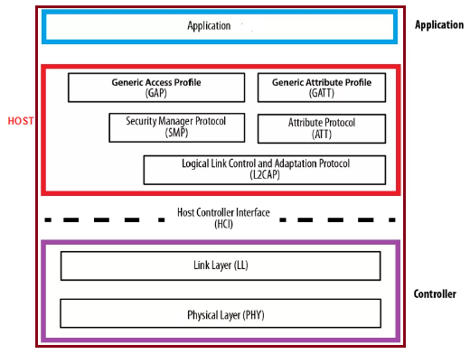
Architectural representation of BLE Stack
1.Controller:
Host Controller Interface (HCI) - For the controller Side (There should be one for the host side)
to enable interoperability between hosts and controllers produced by different manufacturers.
Link Layer (LL)
Defines packet structure and control
Physical Layer (PHY)
Takes care of the transmission/reception.
This layer takes care of Modulation / Demodulation.
Takes care of the Analog to Digital Conversion.
Can communicate over 40 Channels.

Slide 33
2. Host
Generic Access Profile (GAP) - Takes care of the Device Discovery, Connection Establishment, Connection Management and Security. This layer is "MANDATORY" for all BLE devices.
Generic Attribute Profile (GATT) - Takes care of the data exchange. Definition and guidelines for the devices to read/write and push data is done here.
Attribute Protocol (ATT) - Protocol for accessing data
L2CAP - Expanded as " Logical Link Control and Adaptation Protocol (L2CAP)". Responsible for Fragmentation and de-fragmentation of the application data. Also, takes care of the multiplexing and de-multiplexing of channels over the shared logical link.
Security Manager (SM) - Pairing, Authentication, and Encryption (all that is important for the security aspect is taken care, here)
Host Controller Interface (HCI) from the Host Side - Same work, but for the Host, this time.

Slide 34
3.Application Layer:
Application layer is the top most, as in OSI(Open System Interconnection).
This layer is responsible for
UI(User Inerface)
Logic
Data Handling

Slide 35
BLE Topology
A BLE device shall be able to communicate to outside world by two means:
Broadcasting
Connections.

Slide 36
Broadcasting
Broadcasting is
Sending out message to more than one recipient.
With this broadcast, “data” is sent out “one-way”
Whichever device is capable of picking the data (receiving), it will. (Radio Broadcast)
Observer
Observer
Observer
Bluetooth Broadcaster (it is device)
Observer
Observer
Observer

Slide 37
There are two terms to be understood:
Broadcaster - Sends out the “non connectable” advertising packets in frequent intervals to all the ones who are willing to collect it! (Eg. Radio Broadcast)
Observer - Will keep scanning at the preset frequency looking out to receive any nonconnectable packets which are being broadcasted
Broadcasting is the only way a device can transmit data to more than one peer at a time.

Slide 38
Connections
Second possible way of Communication. Connection is permanent.
It enables periodical data transfer between the devices (Two devices).
The term Master Slave Configuration will come into picture.
Master will try to find out the connectable advertising packets. If found, the connection would be initiated. After the connection gets established, the central device (i.e. the master) shall take care of the periodic data exchange.
Slave (Peripheral)
Slave (Peripheral)
Slave (Peripheral)
Master (Could be your mobile)
Slave (Peripheral)
Slave (Peripheral)
Slave (Peripheral)

Slide 39
Connections
Slave shall keep sending the connectable advertising packets, periodically.
When there is an incoming request, it would be accepted by the slave as well.
When two devices get connected we call it “Connection Event”
This is ideal for power saving. When needed, power up happens, data exchange happens, then can sleep
So, waking up happens only when data has to be transmitted.
Slave (Peripheral)
Slave (Peripheral)
Slave (Peripheral)
Master (Could be your mobile)
Slave (Peripheral)
Slave (Peripheral)
Slave (Peripheral)

Slide 40
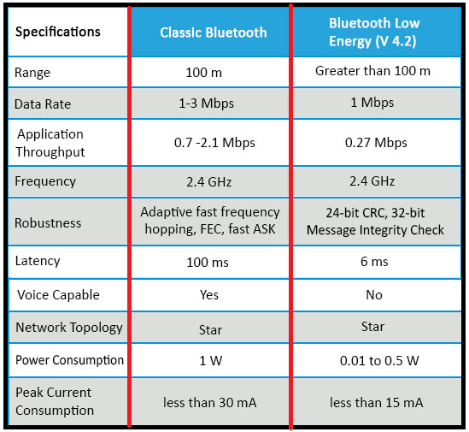
Bluetooth Vs. BLE

Slide 41

Li-Fi – Light Fidelity
Now a days, too many devices are connected to internet.
Everything and anything, from watch to water heater is connected to internet and internet is used like oxygen.
Li-Fi (also written as LiFi) is a wireless communication technology which utilizes light to transmit data and position between devices. Speed stunning: 224Gbps (data rate)
In technical terms, Li-Fi is a light communication system that is capable of transmitting data at high speeds over the visible light, ultraviolet, and infrared spectrums. In its present state, only LED lamps can be used for the transmission of data in visible light.

Slide 42

What is wi-fi?
It is a technology that permits an electronic device to transfer data using radio waves (type of electromagnetic radiation) over a computer network, including high-speed Internet connections.
RF is not safe.
Wi-Fi – Is Not at all safe.
Speed – Not really encouraging. Good for people standing close the access points.

Slide 43

In terms of its end use, the technology is similar to Wi-Fi — the key technical difference being that Wi-Fi uses radio frequency to induce a voltage in an antenna to transmit data, whereas Li-Fi uses the modulation of light intensity to transmit data.
Li-Fi can theoretically transmit at speeds of up to 100 Gbit/s.
Li-Fi's ability to safely function in areas otherwise susceptible to electromagnetic interference (e.g. aircraft cabins, hospitals, military) is an advantage.
Another big advantage of LiFi is that the usage of light allows LiFi connections to occur almost instantaneously because light travels at extremely fast speeds.
This results in faster transmission of data and faster internet connections – about 100 times faster than speeds achievable by WiFi.

Slide 44

Li-Fi is :
High Speed Bi-directional
Used for Communication of data
Light is the source. i.e. data transfer happens through light.
Light is generated through Light Bulbs.
unlike “Wi-Fi”, it is “Transferring data through the light spectrum”
All the challenges in Wi-Fi with respect to security/bandwidth etc. could be avoided here.

Slide 45
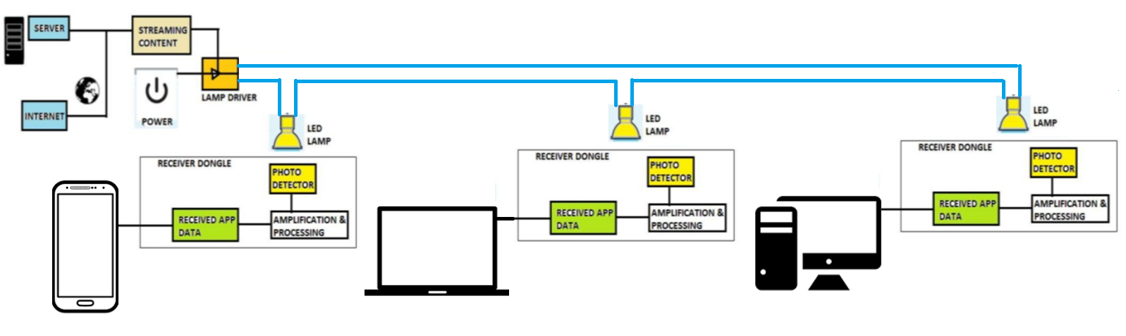
Functioning of Li-Fi

Slide 46
Data is transmitted over Li-Fi by modulating the intensity of a light- essentially dimming the light or turning it on and off at a very high speed.
This happens very fast and human eyes cant really feel or see this.
The light gets received by Photo detector and demodulation (processing) happens to generate the data stream which was sent by the transmitter.
4. All the LED Lamps (As shown) need an LED LAMP DRIVER.
5. This driver gets the info from the server and the encoding happens here.
6. With this the LED illumination (Flicker) happens and human eyes will fail reading it.
7. The photo detector , shall be able to read this and this gets converted as the data. (After the amplification / processing as shown)

Slide 47
Advantages
1. Secured.
2. Efficient
3. Fast
4. Is an effective alternate to RF.
Disadvantages
1. Since, walls are there, it could be short range.
2. Infra set up could take a bit more time to make it practically viable.
3. Still, A major challenge for us to face : how the receiving device will
transmit back to transmitter.

Slide 48
IP V4
An IP address is a unique identification for a node which is connected on a network.
Networks using TCP/IP protocol route messages based on this unique IP address only. Typically IP address will look like 10.10.127.220.
This is called as IP-Version 4 and IP Version6 is also being used globally these days.
IP addresses are 4 bytes or 32 bits long.
They can be represented as binary or decimal format.
Since decimal formats are much easier to remember many stay with decimal way of writing IP.

Slide 49
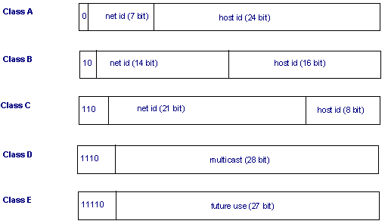

Slide 50
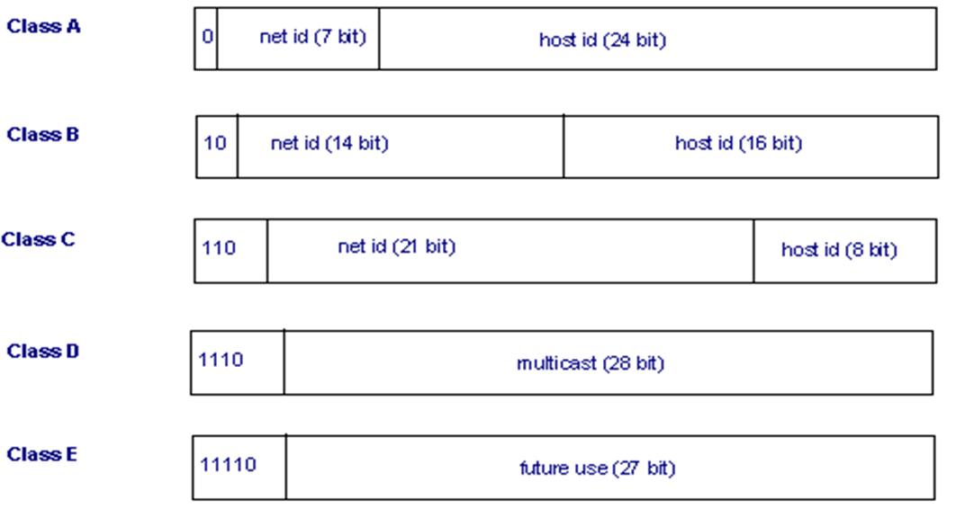
Class A
This class is meant for a very huge network.
In this IP address class, first octet can be from 1 to 126.
It means there can be 126 networks possible with Class A. The first bit of first octet will always be set to zero.
The Remaining 24 bits (3 octets) represent the host ID. With this class there can be (2 ^ 24)-2)) IP addresses.
So, this class IP will be used by large networks.

Slide 51
127 is used as a loop back address which is used for trouble shooting purpose.
This means that it is used by the host computer to send a message back to itself.
It is commonly used for troubleshooting and network testing.

Slide 52
Class B
It is meant for medium sized networks. An instance would be a school or a college campus.
it was finished with 127 there in class A, so here it will start with 128. It ends with 191.
Class B addresses will have second octet included as Net ID and so only 2 octets will be part of host id.
The first two bits of the first octet are fixed to 1 0. Hence in this case (2 ^ 14) - 2, i.e. 16,384 networks are possible each with 65,534 hosts.
Class B addresses can be identified on a glance with looking at the first byte. If it is from 128 to 191, one can confirm it as class B IP.

Slide 53
Class C
Class C IP addresses are used in small networks.
First 3 octets are representing the net id and last octet is representing the net id.
Since class B ended with 191, here it starts with 192 and goes till 223.
First three bits of first octet are fixed as 1 1 0 for class C address. So 21 bits will form the net id. It allows 2,097,152 networks and 254 ((2 ^ 8)- 2 ) hosts per network.

Slide 54
Class D
This class is used for multicasting. Class D, in first its first octet has first bit as 1, second bit as 1, third too is 1 and the 4th bit is 0. The addresses start with 224 and ends with 239.

Slide 55
Class E
Class E IP addresses are used for experimental purposes only. Like Class D, it is different from the first three classes. It has a first bit value of 1, second bit value of 1, third bit value of 1 and fourth bit value of 1.

Slide 56
Internet Protocol IPv4 Format
IP Version Number: It is half a byte field (4 bits) which indicates which version of IP is being utilized. Here the discussion is fully on Version 4. So this field has the value 4 in binary (0100). The basic idea of using this version field is to ensure the compatibility between the versions of IP that might be used in network.
Internet Header Length: This length specifies internet header length in 32 bit words, and points to the beginning of the data. Minimum value for a correct header is 5. (0101)

Slide 57
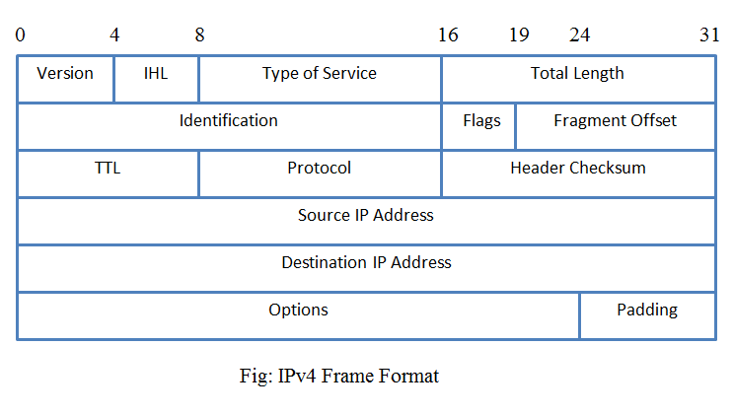

Slide 58
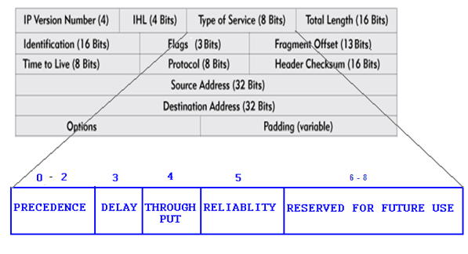
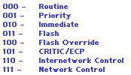
Type of service: This is an eight bit field which indicates on the quality of service. QoS can be precedence, delay and reliability
Delay - This is the 4th bit and it indicates the delay. If it is ‘0’ then it indicates the normal delay and ‘1’ indicates a lower delay.
Throughput – ‘0’ indicates normal delay and ‘1’ indicates high throughput.
Reliability - ‘0’ indicates the normal reliability and ‘1’ indicates the high reliability.

Slide 59
Total Length – This is a 16 bit field which defines the length of the IPV4 datagram. Thus length includes header and data. Minimum length of the IP datagram is 20 bytes and the maximum can be 65,535 bytes (2 ^ 16 = 65535).
Identification – This is an identification aid added by sender to help in assembling the fragments.
This is a 16 bits field.
Helps in organizing data.
If the message sent is too large to fit in one packet, it will be then spilt to multiple child packets.
To identify them all there will be a unique identifier for all the spilt packets. This makes the receiver’s job easier to rebuild the received data.

Slide 60
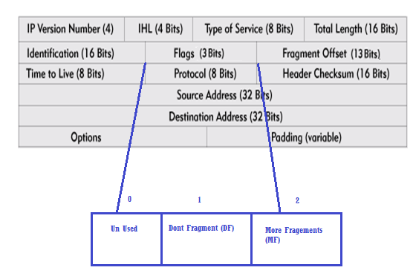
Flags– Flags field is composed of three bits.
First bit of that will be always zero and it is kept unused. Second bit is called as DF (Don’t Fragment) flag, DF if set to ‘0’ IP datagram can be fragmented.
And if set to ‘1’ it cannot be fragmented. Next bit is called as More Fragments (MF) which if set will indicate that more fragments are coming on the way

Slide 61
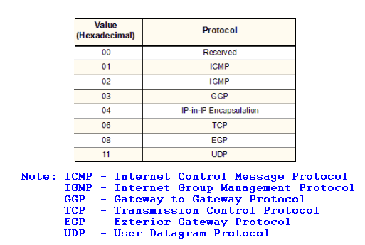
Fragment offset - When fragmentation of a message occurs, this field specifies the offset, or position, in the overall message where the data in this fragment goes. It is specified in units of 8 bytes (64 bits). The first fragment has an offset of 0.
Time to Live- This is an 8 bit field and this indicates the time that IP datagram should survive. There will be a time set and that will be decremented by 1 and router will be having an eye on it. When it reaches zero the datagram can be discarded.
Protocol – This will serve as an identifier for the higher layer protocol carried in the IP datagram. The protocols can be ICMP, IGMP, TCP or UDP. Figure 5.8 reveals few of the protocols used for this field along with Hex code.

Slide 62
Header checksum - A checksum computed over the header to provide basic protection against corruption in transmission. It is just a 16-bit checksum. It is calculated by dividing the header bytes into words and then adding them together. The data is not check summed, only the header. At each hop the device receiving the datagram does the same checksum calculation and on a mismatch, discards the datagram as damaged.
Source address -The 32-bit IP address of the source (originator) of the datagram.
Destination address - The 32-bit IP address of the destination which will have to receive the IP datagram.
Options –There are lot of optional header settings available and they are used for the debugging/testing and security purposes.

Slide 63
Padding - Internet Protocol Options field may vary in length. So the Padding field provides additional zero bits so that the total header length is an exact multiple of 32 bits.

Slide 64
IP V6
It overcomes the difficulties faced with IPV4.
IP V6 - version 6, is also named as the next generation protocol for the internet
It also works in Layer 3
Has more addresses and multiple features to appreciate.
IPV6 provides support for 2^128 unique IP addresses, a substantial increase in number of computers that can be addressed with the help this scheme.

Slide 65
1. More number of IP address is the primary benefit.
2. Much better and efficient routing.
3. IPsec framework is made mandatory in IPV6, which is not so in IPV4. This increases the security.(Now, this is optional)
4. An additional flow label is added in header of IPV6, which can improve the Quality of Service.
5. IPV6 supports new applications such as IP telephony, video/audio, interactive games etc., with a ensured QoS where IPV4 is not so as it is a best effort service. So QoS is one of the most important benefits with IPV6.
6. Plug and play abilities have been improved in IPV6.
7. IPV6 has eliminated the need for Network Address Translation due to the huge availability of IP addresses.

Slide 66
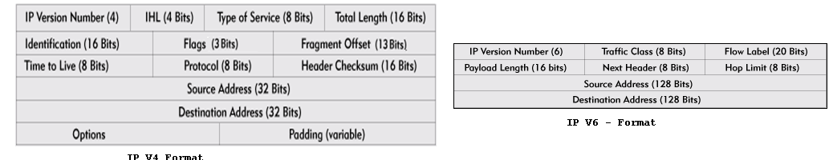
IPv6 cuts down some IPv4 header fields or move them to IPv6 extension headers to reduce the load of basic IPv6 headers, thus making IPv6 packet handling simple and improving the forwarding efficiency.
Although the IPv6 address size is four times that of IPv4 addresses, the size of basic IPv6 headers is 40 bytes and is only twice that of IPv4 headers (excluding the Options field)

Slide 67
1. Version - 4 bits - It is used to represent the version of IP being used. In IPV4 it is 4 and in IPV6 it is 6.
2. Traffic Class - 8 bits - An 8-bit field that provides the means of identifying different classes or priorities of IPv6 packets. It replaces the TOS field of IPV4. MSB 6 bits are used for Type of Service to let the Router Known what services should be provided to this packet.
LSB 2 bits are used for Explicit Congestion Notification
3. Flow Label - 20 bits - Used to identify the sequence of packets. It helps in prioritizing the packet delivery. It helps in providing real time service. The vital packets can be delivered ahead of the lower priority packets.

Slide 68
4. Payload length -16 bits - Identifies the length of the IPv6 payload (the rest of the packet following the IPv6 header). It is used in the place of Total Length of IPV4.
5. Next header - 8 bits - This is similar to the protocol field in IPV4 header. It represents the type of extension header that follows the primary IPV6 header.
6. Hop limit - 8 bits - TTL (Time To Live) is being replaced by Hop Limit in IPV6 header. The value in this field is decremented by one every time the packet passes through a host that forwards the packet. When the value reaches zero, the packet will be discarded.
7. Source Address - As in IPV4, this specifies the sender's IP 128 bit address.
8. Destination Address - Again it is similar to IPV4. The destination's IP address is denoted here.

Slide 69
IPv4 addresses are simple which are composed of 32 bits, and represented as 133.78.21.56 where decimal representation is used and period (.) is used as a separator. This is different with IPV6.
IPv6 addresses are 128 bits long, written in hexadecimal, and separated by colons. An example would be: 3ffe:1900:4545:3:200:f8ff:fe21:67cf
Colons separate 16-bit fields. Leading zeros can be omitted in each field as can be seen above where the field :0003: is written :3:.
In addition, a double colon (::) can be used once in an address to replace multiple fields of zeros.
For example:
fe80:0:0:0:200:f8ff:fe21:67cf can be written as fe80::200:f8ff:fe21:67cf.
Rather than simply suppressing the leading zeros, you can get rid of all of the sequential zeros and replace them with two colons. The two colons tell the operating system that everything in between them is a zero.
IPV6 can also be written in IPV4 format. An instance would be 10.122.132.10 can be represented as ::ffff:10.122.132.10.

Slide 70
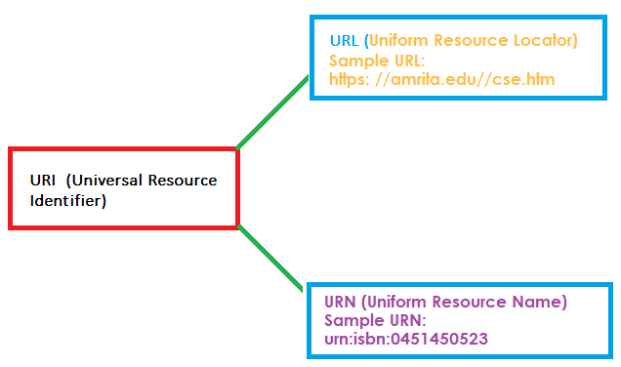
URI (Universal Resource Identifier) / URL / URN
URI – Sequence of characters – used to identify resources.
Resources can be Logical or Physical.
Guidelines are issued by IETF – Internet Engineering Task Force.
URI Has URN / URL in it . Means, URL / URN are babies of the mother URI.
URIs tries to identify a resource through a name and to provide a means of locating the resource by describing its primary access mechanism.
URN defines an item’s identity, whereas URL renders(provides) a method for finding it.

Slide 71
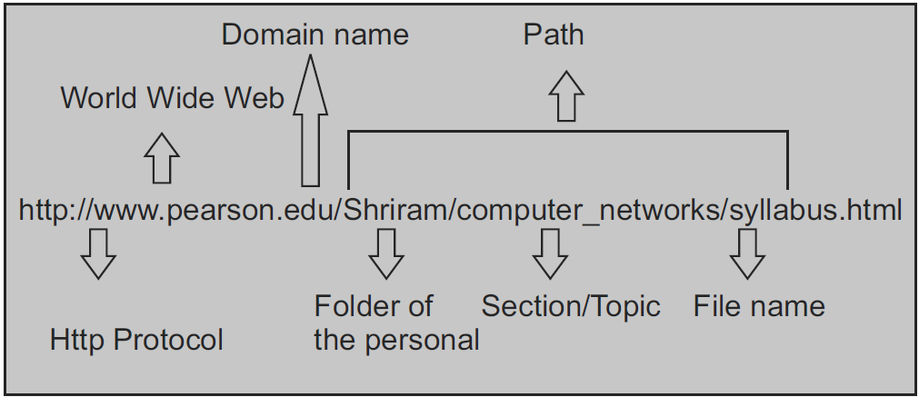
URL has information about how to fetch / acquire a resource from its location.
URLs always begin with a protocol. (Most obvious, HTTP)
It will have the details about the host name
It will have the path.
A URL is used when a client is raising a request to the server for the service.
An example follows:

Slide 72
URN resource name gives the name of a resource and its identification.
However, it does not indicate how to spot it / locate it on the internet.
There is a prefix URN for all the URNs.
When you specify "access mechanism, location" and URI becomes URL.
urn:vehiclenumber:0451450523 identifies a vehicle by its vehicle number.
URIs are identifiers, i.e. name, location, or both.
URNs and URLs are URIs, Vice versa is not correct.
URL is the combination of the name and an access method, such as https://, or mailto:

Slide 73
URL: ftp://ftp.is.co.za/rfc/rfc1808.txt
URL: http://www.ietf.org/rfc/rfc2396.txt
URL: ldap://[2001:db8::7]/c=GB?objectClass?one
URL: mailto:John.Doe@example.com
URL: news:comp.infosystems.www.servers.unix
URL: telnet://192.0.2.16:80/
URN (not URL): urn:oasis:names:specification:docbook:dtd:xml:4.1.2

